Slide 1
Boolean& Comparison Operations

Slide 2
SELECT Statement
Used for queries on single or multiple tables
Clauses of the SELECT statement:
  SELECT
    List the columns (and expressions) that should be returned from the query
  FROM
    Indicate the table(s) or view(s) from which data will be obtained
  WHERE
    Indicate the conditions under which a row will be included in the result
  GROUP BY
    Indicate categorization of results
  HAVING
    Indicate the conditions under which a category (group) will be included
  ORDER BY
    Sorts the result according to specified criteria

Slide 3
Example
SELECT CTITLE, CHRSW
FROM COURSE;
SELECT * FROM COURSE;
SELECT CTITLE, CHRSW
FROM COURSE
WHERE CRS = 706;

Slide 4
Boolean Operators in SQL
AND, OR, and NOT Operators for customizing conditions in WHERE clause

Slide 5
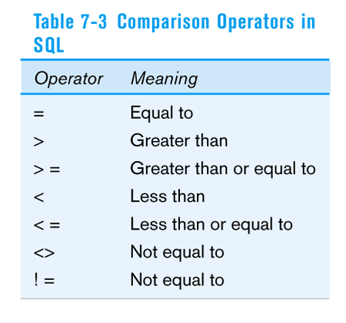
Comparison Operators in SQL

Slide 6
Example Continued
SELECT *
FROM COURSE
WHERE CHRS >= 60 AND CHRSW = 15;
SELECT CTITLE, CHRSW
FROM COURSE
WHERE CHRS >= 60 and CHRS < =100;

Slide 7
Continued
SELECT CTITLE, CHRSW
FROM COURSE
WHERE CHRS BETWEEN 60 and 100;
SELECT CTITLE, CHRSW
FROM COURSE
WHERE CHRS >= 60 OR CRS = 706;

Slide 8
Aggregate Functions

Slide 9
Aggregate Functions
COUNT : to count the number of rows of the relation
MAX : to find the maximum value of the attribute (column)
MIN : to find the minimum value of the attribute
SUM : to find the sum of values of the attribute provided the data type of the attribute is number
AVG : to find the average of n values, ignoring null values
STDDEV: standard deviation of n values ignoring null values
VARIANCE : variance of n values ignoring null values

Slide 10
COUNT
SELECT COUNT (*)
FROM table name;
  Returns No of rows of a relation
SELECT COUNT (attribute name)
FROM table name;
  Returns No of rows of a relation
SELECT COUNT (DISTINCT attribute name)
FROM table name;
  returns the number of rows of the relation, by eliminating duplicate values.

Slide 11
MAX Command
SELECT MAX (attribute name)
FROM table name;
to get the maximum price of the product
Select max(Price)
From consumer_product;
To get the product name with maximum price
Table Consumer product
Name Price
TV 15,000
refrigerator 10,000
washing machine 17,000
mixer 3,500
Select Name from Consumer_product
Where price in
(select max(price) from consumer_product);

Slide 12
Min Command
SELECT MIN (attribute name)
FROM table name;
to get the Minimum price of the product
Select min(Price)
From consumer_product;
To get the product name with minimum price
Table Consumer product
Name Price
TV 15,000
refrigerator 10,000
washing machine 17,000
mixer 3,500
Select Name from Consumer_product
Where price in
(select min(price) from consumer_product);

Slide 13
AVG Command
The AVG command is used to get the average value of an attribute. The syntax of AVG command is:
SELECT AVG (attribute_name)
FROM table_name;

Slide 14
GROUP BY Function
The GROUP BY clause is used to group rows to compute group-statistics.
It is to be noted that when the GROUP BY clause is present, then
  the SELECT clause may include only the columns that appear in the GROUP BY clause and aggregate functions.
The general Form
  SELECT attribute name, aggregate function
  FROM table name
  GROUP BY attribute name;

Slide 15
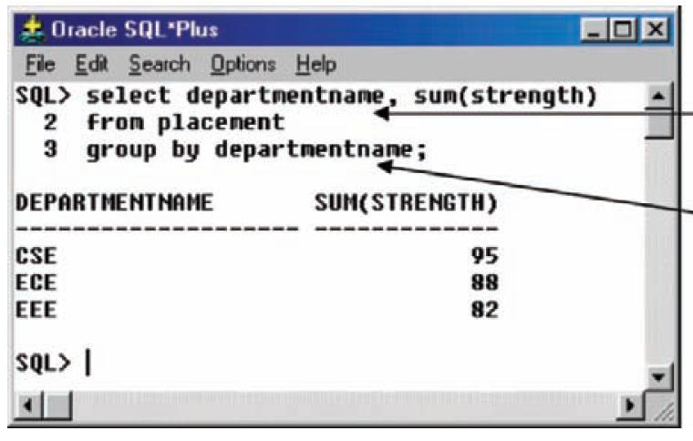
Example Group by

Slide 16
Having Command
The HAVING command is used to select the group. In other words HAVING restricts the groups according to a specified condition.
The syntax of HAVING command is:
  SELECT attribute name, aggregate function
  FROM table name
  GROUP BY attribute name
  HAVING condition;

Slide 17
Example
Find the details of the department in which more than 90 students got placement

Slide 18
Chapter 8:
Advanced SQL
Modern Database Management
6th Edition
Jeffrey A. Hoffer, Mary B. Prescott, Fred R. McFadden

Slide 19
Processing Multiple Tables – Joins
Join – a relational operation that causes two or more tables with a common domain to be combined into a single table or view
Equi-join – a join in which the joining condition is based on equality between values in the common columns; common columns appear redundantly in the result table
Natural join – an equi-join in which one of the duplicate columns is eliminated in the result table
Outer join – a join in which rows that do not have matching values in common columns are nonetheless included in the result table (as opposed to inner join, in which rows must have matching values in order to appear in the result table)
Union join – includes all columns from each table in the join, and an instance for each row of each table
The common columns in joined tables are usually the primary key of the dominant table and the foreign key of the dependent table in 1:M relationships.

Slide 20
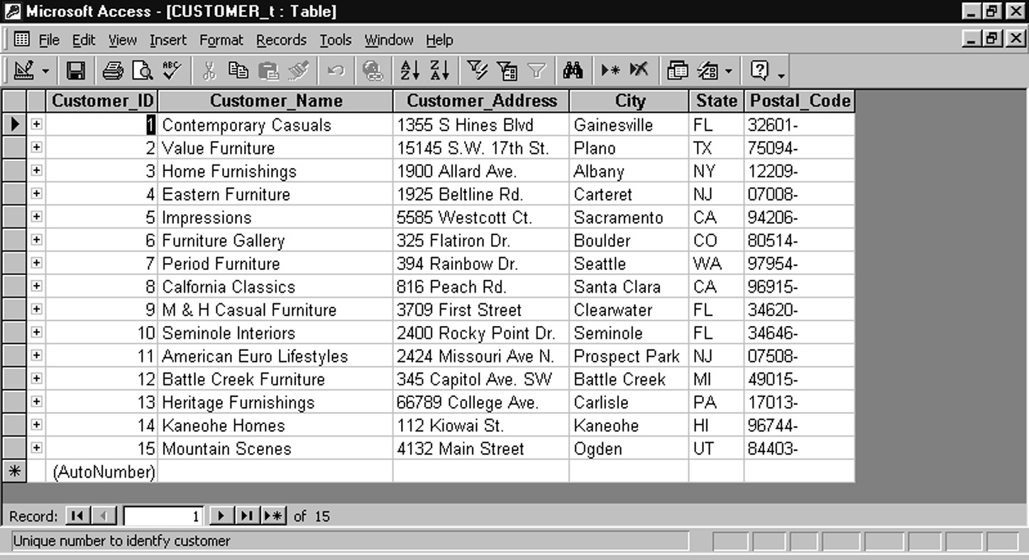
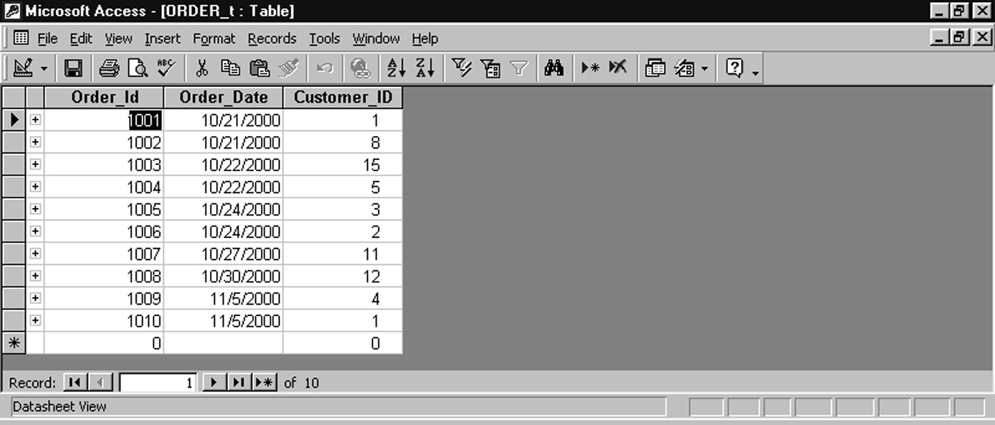
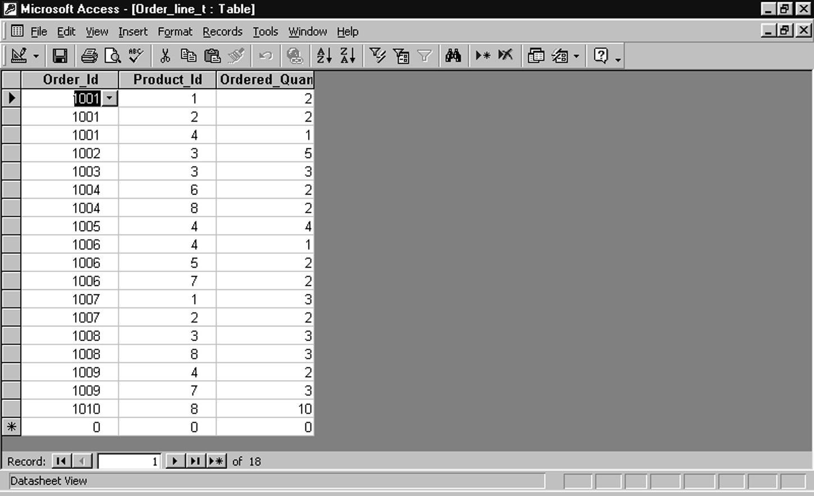
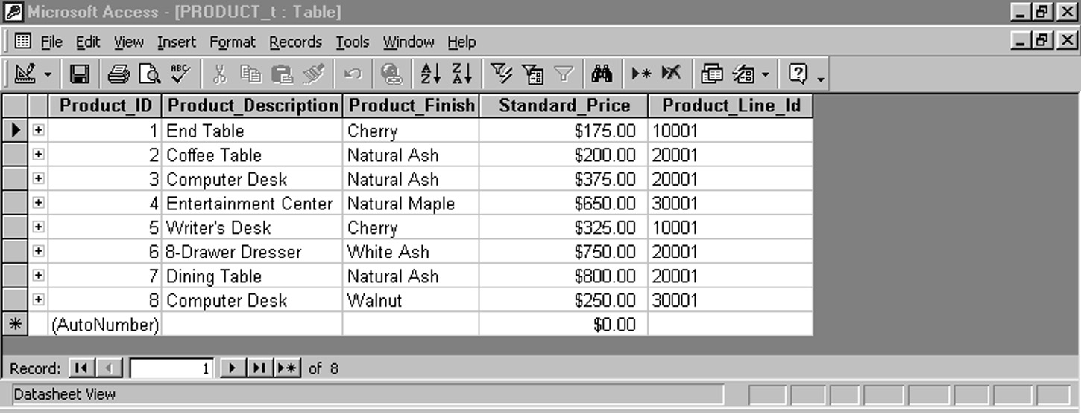
Figure 7-3 revisited: Sample Pine Valley Furniture data
customers
orders
order lines
products

Slide 21
Natural Join Example
For each customer who placed an order, what is the customer’s name and order number?
SELECT CUSTOMER. CUSTOMER_ID, CUSTOMER_NAME, ORDER_ID
FROM CUSTOMER, ORDER
WHERE CUSTOMER.CUSTOMER_ID = ORDER.CUSTOMER_ID
Join involves multiple tables in FROM clause
WHERE clause performs the equality check for common columns of the two tables

Slide 22
Outer Join Example
List the customer name, ID number, and order number for all customers. Include customer information even for customers that do have an order
SELECT CUSTOMER. CUSTOMER_ID, CUSTOMER_NAME, ORDER_ID
FROM CUSTOMER, LEFT OUTER JOIN ORDER
WHERE CUSTOMER.CUSTOMER_ID = ORDER.CUSTOMER_ID
LEFT OUTER JOIN syntax will cause customer data to appear even if there is no corresponding order data

Slide 23
Multiple Table Join Example
Four tables involved in this join
Assemble all information necessary to create an invoice for order number 1006
SELECT CUSTOMER.CUSTOMER_ID, CUSTOMER_NAME, CUSTOMER_ADDRESS, CITY, SATE, POSTAL_CODE, ORDER_T.ORDER_ID, ORDER_DATE, QUANTITY, PRODUCT_NAME, UNIT_PRICE, (QUANTITY * UNIT_PRICE)
FROM CUSTOMER, ORDER, ORDER_LINE, PRODUCT
WHERE CUSTOMER.CUSTOMER_ID = ORDER_LINE.CUSTOMER_ID AND
ORDER.ORDER_ID = ORDER_LINE.ORDER_ID
  AND ORDER_LINE.PROEUCT_ID = PRODUCT_PRODUCT_ID
  AND ORDER.ORDER_ID = 1006;
Each pair of tables requires an equality-check condition in the WHERE clause, matching primary keys against foreign keys

Slide 24
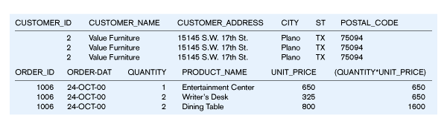
Figure 8-1 – Results from a four-table join
From CUSTOMER table
From ORDER table
From PRODUCT table

Slide 25
Processing Multiple Tables -- Subqueries
Subquery = placing an inner query (SELECT statement) inside an outer query
Options:
  In a condition of the WHERE clause
  As a “table” of the FROM clause
  Within the HAVING clause
Subqueries can be:
  Non correlated – execute once for the entire outer query
  Correlated – execute once for each row returned by the outer query

Slide 26
Subquery Example
Show all customers who have placed an order
SELECT CUSTOMER_NAME FROM CUSTOMER
WHERE CUSTOMER_ID IN
  (SELECT DISTINCT CUSTOMER_ID FROM ORDER);
The IN operator will test to see if the CUSTOMER_ID value of a row is included in the list returned from the subquery
Subquery is embedded in parentheses. In this case it returns a list that will be used in the WHERE clause of the outer query

Slide 27
Correlated vs. Noncorrelated Subqueries
Non-correlated subqueries:
  Do not depend on data from the outer query
  Executes once for the entire outer query
Correlated subqueries:
  Does make use of data from the outer query
  Executes once for each row of the outer query
  Can make use of the EXISTS operator

Slide 28
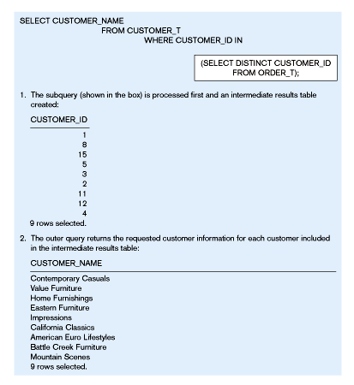
Figure 8-2(a) – Processing a noncorrelated subquery
No reference to data in outer query, so subquery executes once only

Slide 29
Correlated Subquery Example
Show all orders that include furniture finished in natural ash
SELECT DISTINCT ORDER_ID FROM ORDER_LINE
WHERE EXISTS
  (SELECT * FROM PRODUCT_T
  WHERE PRODUCT_ID = ORDER_LINE.PRODUCT_ID
  AND PRODUCT_FINISH = ‘Natural ash’);
The EXISTS operator will return a TRUE value if the subquery resulted in a non-empty set, otherwise it returns a FALSE
The subquery is testing for a value that comes from the outer query

Slide 30
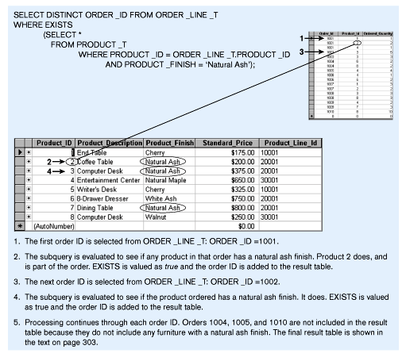
Figure 8-2(b) – Processing a correlated subquery
Subquery refers to outer-query data, so executes once for each row of outer query

Slide 31
Subquery Example – Using a Derived Table
Which products have a standard price that is higher than the average standard price?
SELECT PRODUCT_DESCRIPTION, STANDARD_PRICE, AVGPRICE
FROM
    (SELECT AVG(STANDARD_PRICE) AVGPRICE FROM PRODUCT_T),
    PRODUCT_T
    WHERE STANDARD_PRICE > AVG_PRICE);
One column of the subquery is an aggregate function that has an alias name. That alias can then be referred to in the outer query
Subquery forms the derived table used in the FROM clause of the outer query
The WHERE clause normally cannot include aggregate functions, but because the aggregate is performed in the subquery its result can be used in the outer query’s WHERE clause

Slide 32
Data Dictionary Facilities
System tables that store metadata
Users usually can view some of these tables
Users are restricted from updating them
Examples in Oracle8i
  DBA_TABLES – descriptions of tables
  DBA_CONSTRAINTS – description of constraints
  DBA_USERS – information about the users of the system
  DBA_TAB_PRIVS – descriptions of grants on objects in the database

Slide 33
Embedded and Dynamic SQL
Embedded SQL
  Including hard-coded SQL statements in a program written in another language such as C or Java
Dynamic SQL
  Ability for an application program to generate SQL code on the fly, as the application is running

